Slide 1
AM - LATAM Divestiture Day 1

Slide 2
New AppSecure Role to identify LATAM Users :
By default, everyone has browse access today. Only if a user is set with this new role, the browse should be allowed for a user to view the LATAM owned accounts
Otherwise by default, LATAM accounts should be restricted even on the general browse access

Slide 3
LATAM Operating Companies
OPERATING_COMPANY | DESCRIPTION | FINANCE_ACCOUNT_NUMBER_TAG
639 | Brazil
638 | Argentina
642 | Colombia
637 | Ecuador
644 | Peru
645 | Chile
649 | Venezuela
646 | LEVEL 3 MEXICO LANDING S. DE R.L. | -GC
634 | LEVEL THREE COMMUNICATIONS COSTA RICA, S.R.L. | -GC
631 | LEVEL 3 PANAMA, INC | -GC
625 | GC SAC ARGENTINA S.R.L. SUCURSAL URUGUAY | -A
*As on 10/11/2021

Slide 4
LATAM Customer & BAN Counts
OPERATING_COMPANY | DESCRIPTION | Customer Count | BAN Count
639 | Brazil | 10474 | 18996
638 | Argentina | 6174 | 10049
642 | Colombia | 4997 | 6029
637 | Ecuador | 2717 | 3479
644 | Peru | 2692 | 5351
645 | Chile | 2037 | 3173
649 | Venezuela | 1460 | 2090
646 | LEVEL 3 MEXICO LANDING S. DE R.L. | 451 | 1098
634 | LEVEL THREE COMMUNICATIONS COSTA RICA, S.R.L. | 4 | 207
631 | LEVEL 3 PANAMA, INC | 3 | 216
625 | GC SAC ARGENTINA S.R.L. SUCURSAL URUGUAY | 2 | 77
 | Total | 31011 | 50765
Customer | Status
22711 | Approved
6351 | PNDG
1145 | Rejected
745 | INACTV
40 | On Hold
19 | Request
BANs | Status
50551 | Act
15 | Cancelled
133 | Inact
20 | Pend
48 | TaxProfile
***Count as on 10/11/2021

Slide 5
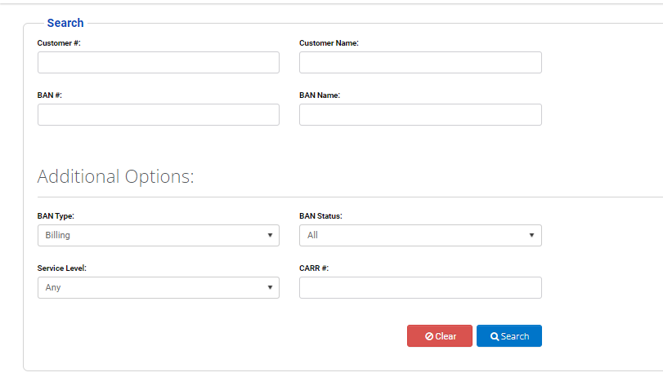
Search Screen
Check if LATAM User
Display results if searched for LATAM customer/BAN if it’s a LATAM user

Slide 6
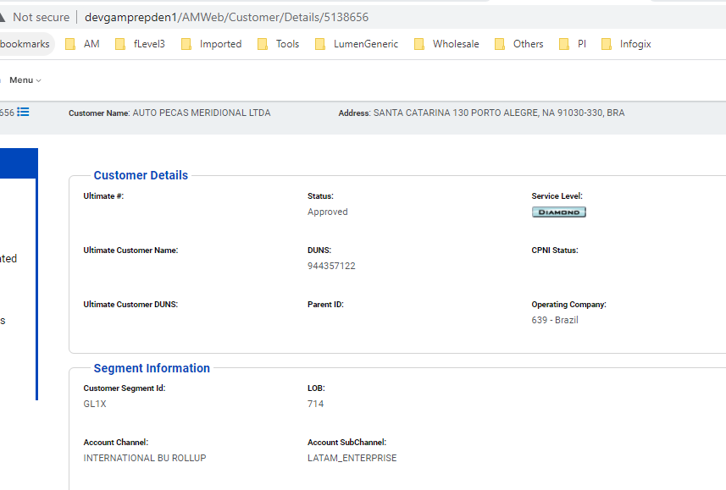
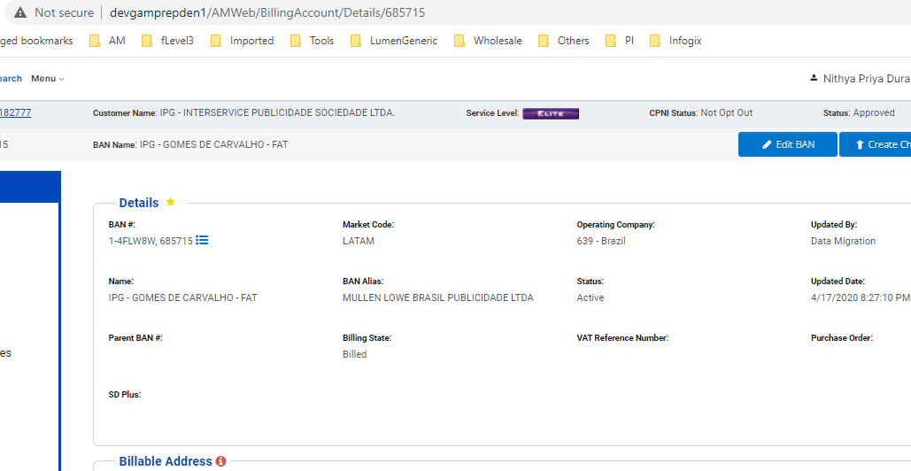
Direct Access on URL to customer details or BAN Details
For a LATAM user, display results if searched for LATAM owned customer/BAN
For a Lumen user, display results if searched for Lumen owned customer/BAN
Restrict access if its vice-versa

Slide 7
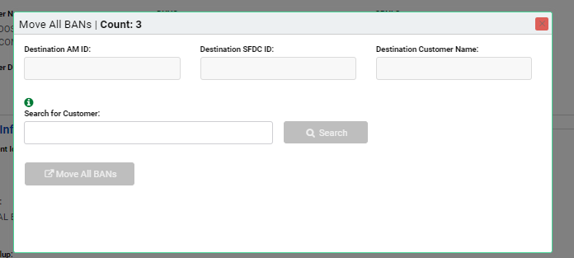
Move BANs / Move All BANs
Allow BAN movements between LATAM to LATAM owned BusOrg
Allow BAN movements between Lumen to Lumen owned BusOrg movements
Restrict BAN movements between LATAM owned to Lumen owned and vice-versa

Slide 8
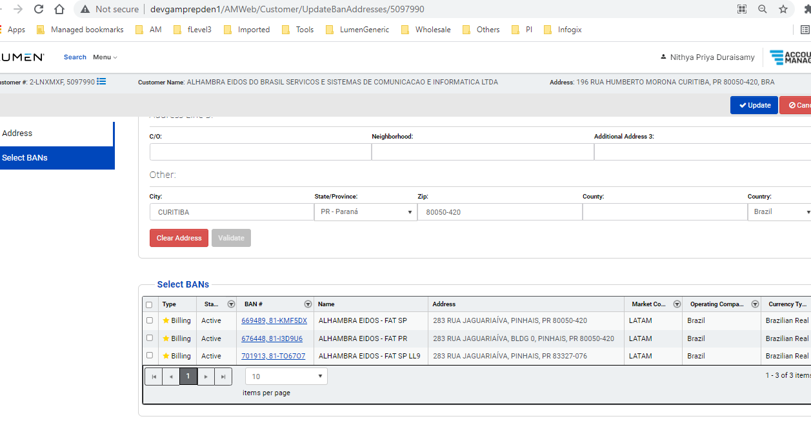
Update Addresses Screen
Allow LATAM user to access the Update Addresses screen for LATAM owned Customer
Allow Lumen user to access the Update Addresses screen for Lumen owned Customer
Restrict access for Lumen users to LATAM BANs and vice-versa

Slide 9
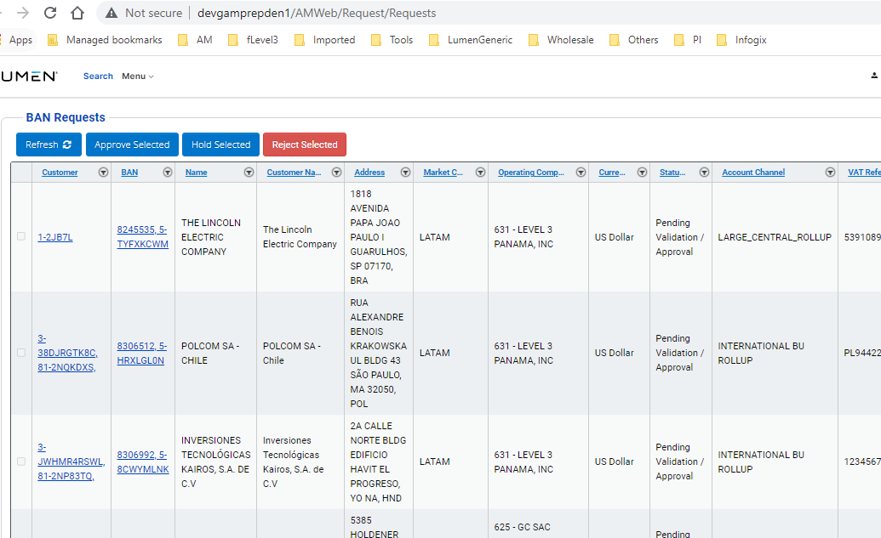
BAN Requests Screen
Show only LATAM owned BANs to be reviewed/approved for LATAM User
Show only Lumen owned BANs to be reviewed/approved for Lumen ser

Slide 10
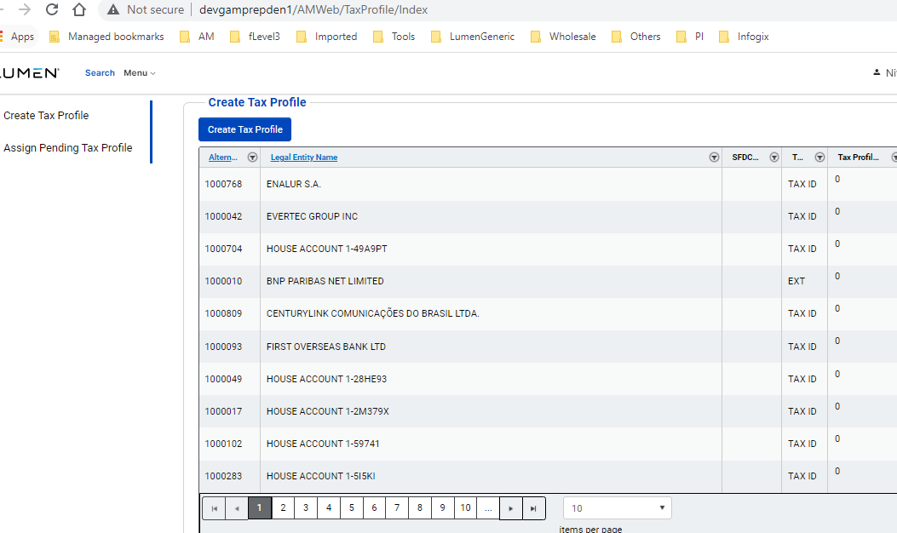
Tax Profile Screen
Allow access to Tax profile only for LATAM Users

Slide 11
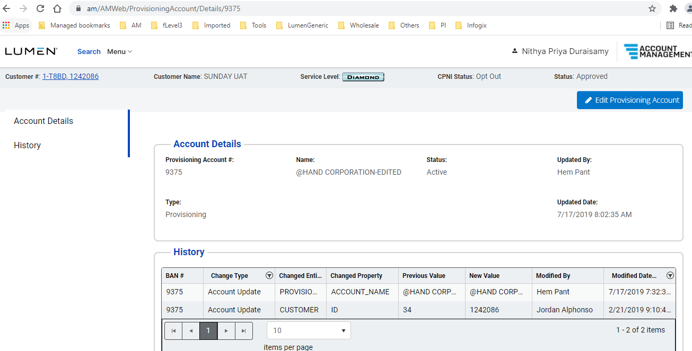
Provisioning Account Screen
Show only LATAM owned BANs for LATAM Users
Show only Lumen owned BANs for Lumen users

Slide 12
Ultimate Customer have combo of both LATAM and Lumen Owned Customers
May need attention on :
View Hierrachy:
Example:
1-8MJ8PL-UC
OCC | OCC Name | Customer Count
 |  | 5891
637 | Ecuador | 97
638 | Argentina | 66
644 | Peru | 3
Total |  | 6057

Slide 13
2- BANs marked as NA
May need attention on :
OPERATING_COMPANY | MARKET_CODE | BILLING_ACCOUNT_ID | ALTERNATE_BILLING_ACCOUNT_ID | ACCOUNT_NAME | ACCOUNT_STATUS | CREATED_DATE | MODIFIED_DATE | CREATED_BY | MODIFIED_BY
646 | NA | 559724 | 1-C5XZ39 | Cablemas Telecomunicaciones, S.A. de CV | Act | 7/18/2013 | 3/19/2019 | Siebel Migrated | AM Admin
646 | NA | 7540848 | 5-SFWCSDSR | TENEDORA DE CINES SA DE CV | Act | 8/22/2019 | 3/11/2021 | Rodrigo Thion Parmegiani Ong | AM Admin
913 – Lumen owned BANs (marked as NA) but has Tax Profile Assigned
350 – Lumen owned Customers has the Brazil Address assigned

Slide 14
Examples
Lumen owned BANs (marked as NA) but has Tax Profile Assigned
OPERATING_COMPANY | MARKET_CODE | BILLING_ACCOUNT_ID | ALTERNATE_BILLING_ACCOUNT_ID | ACCOUNT_NAME | ACCOUNT_STATUS | CREATED_DATE | MODIFIED_DATE | CREATED_BY | MODIFIED_BY
273 | NA | 661393 | 1-13U8NU | HOUSE ACCOUNT 1-13U8NU | Act | 1/1/2001 | 4/17/2020 | LATAM Migrated | Data Migration
273 | NA | 661430 | 1-156V0Z | BCE NEXXIA - JAMAICA | Act | 1/1/2001 | 4/17/2020 | LATAM Migrated | Data Migration
273 | NA | 661483 | 1-18LJGQ | GLOBAL CROSSING COLOMBIA S.A. - CARTON DE COLOMBIA S.A. - F1 | Act | 1/1/2001 | 2/28/2021 | LATAM Migrated | Ana Gerlero
273 | NA | 671583 | 1-6XCPG | TELEGLOBE USA INC.TELEGLOBLE | Act | 1/1/2001 | 3/26/2019 | LATAM Migrated | AM Admin
273 | NA | 671618 | 1-7O976 | IMP COL-GECOLSA | Act | 1/1/2001 | 2/28/2021 | LATAM Migrated | Ana Gerlero
Lumen owned Customers has the Brazil Address assigned
CUSTOMER_ID | ALTERNATE_CUSTOMER_ID | NAME | STATUS | OPERATING_COMPANY
980937 | 2-QXSXGS | NTT GLOBAL NETWORKS INCORPORATED | Approved
1057824 | 2-THGKQZ | Alhambra Eidos | Approved
1058620 | 1-AFPV4R | COMPLEXO DE ENSINO RENATO SARAIVA - EPP -1 LATAM | Approved
1077729 | 1-CKS6BQ | GIMBA SUPRIMENTOS DE ESCRITORIO E INFORMATICA LTDA- | Approved
1092675 | 1-8SXFJ6 | FEDERAL EXPRESS CORPORATION-LATAM | Approved

Slide 15
Thank you

